Slide 1


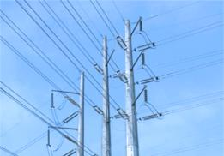

Preparing for Winter Energy Costs
Challenges and Solutions
NU Webinar featuring
JAMES DALY
NU’s Vice President of Energy Supply

Slide 2

Kevin Charette
NU Webinar
About this session
Welcome!
Overview
Interacting with us today
Today’s Moderator
Director, Business Center
Northeast Utilities

Slide 3
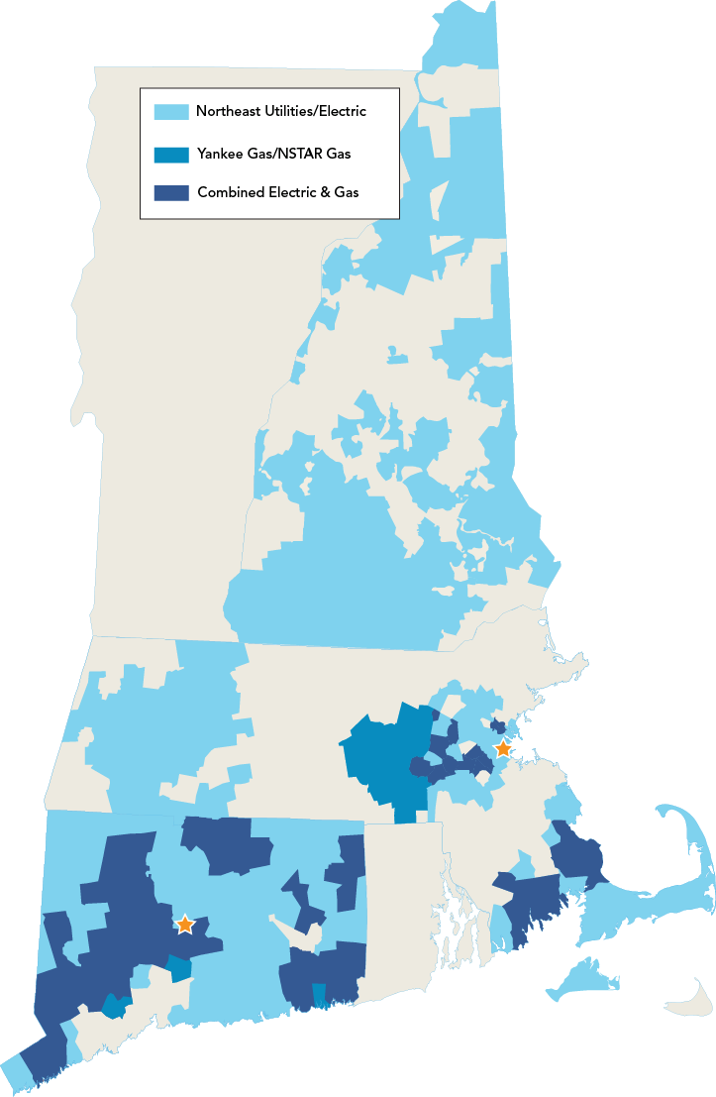
Northeast Utilities’ Profile
Who we are
One company, focused on delivering reliable energy and superior customer service
  3.6 million electric and gas customers
  525 communities in Connecticut, Massachusetts and New Hampshire
  16,600 square miles of service territory

Slide 4
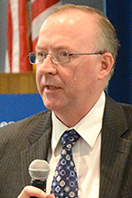
James Daly
NU Webinar
We’re pleased to introduce
What’s happening
Why it’s happening
NU’s proposed solutions
Featured Speaker
Vice President – Energy Supply
Northeast Utilities

Slide 5
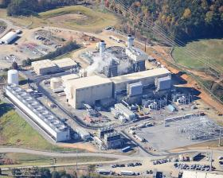
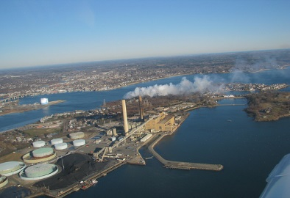
What’s happening?
Multiple regional challenges
Increasing demand for natural gas for heating and power generation without additions to gas infrastructure
Imminent retirement of generation capacity
Aggressive carbon reduction goals increasing amounts of intermittent generation
Grid modernization, reliability and resilience

Slide 6
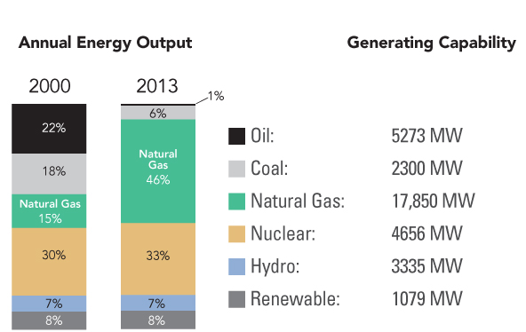
Dependence on natural gas has more than tripled since 2000
Why it’s happening
5,273 MW
2,300 MW
17,850 MW
4,656 MW
3,335 MW
1,079 MW
Notes:
6

Slide 7
Generation Retirements and
Proposed New Projects in New England
Reliance on natural gas is growing
Generator Retirements:
3,230 MW Announced
Coal/Oil 2,284
  Salem Harbor Station, NH
  Brayton Point Station, MA
Oil 342
  Norwalk Harbor Station, CT
Nuclear 604
  Vermont Yankee Station, VT
Up to 8,000 MW potential longer term
New Gas Generation:
Over 4,344 MW Proposed
Fuel Type
Capacity
(MW)
Capacity
(MW)
Fuel Type
Natural Gas/Oil 2,497
Wind* 2,110
Natural Gas 1,847
Oil 245
Biomass/Wood Waste 138
Hydro 62
Solar* 16
Total 6,915
* Intermittent resources
Notes:
7

Slide 8
The Impact
Higher electric prices are a reality for New England this winter
- old rate
per kwh
Residential data for illustration purposes only
- new rate
*
* estimate
Connecticut
Massachusetts
New Hampshire

Slide 9
Energy Service Costs
Energy costs are the largest portion of a CL&P business customer’s bill
Generation
63%

Slide 10
Natural Gas Pipeline Constraints:
The Bottom Line
Wholesale electricity prices
are rising
Winter Season Wholesale Electricity Costs
December – March
($ Billions, ISO-NE* Region)
$6.8
$3.6
$3.1
$1.6
2010 - 2011
2011 - 2012
2012 - 2013
2013 - 2014
* Independent System Operator – New England (ISO-NE), manages New England’s electric grid, ensuring the balance of electric supplies and customer demand.

Slide 11
New England Governors’ response
Solving These Challenges
Address reliability, costs and renewable goals through infrastructure
  Expand natural gas delivery
  New transmission imports for large hydro and renewable energy
Respect each state’s differing interests
  Gas expansion to lower costs, promote economic development
  Renewable and low-carbon energy to meet environmental goals
  All are concerned about electric system reliability
Mutually agreed-upon cost allocation for new infrastructure
Fund through FERC-approved tariff
  Administered by the ISO-NE
  Allocated to all electric customers
  Precedent setting
Implement through New England States Committee on Electricity (NESCOE)
Notes:
11

Slide 12

Solving These Challenges
NU’s position
Stay a committed advocate for customers in the energy marketplace
Promote the development of:
  Electric transmission to achieve energy diversity and greenhouse emission goals
  Natural gas infrastructure to address power market disruptions
Expedite construction of energy infrastructure through the use of tariffs
  Address energy policy objectives through existing regulatory precedents and our regulated utilities
  Electric distribution companies’ proposal to NESCOE for contracting for gas transportation capacity

Slide 13
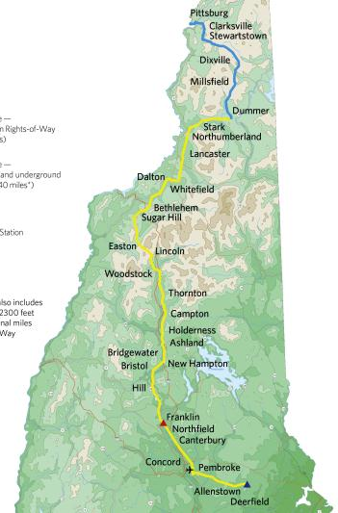
Diversifying Electric Supplies
The Northern Pass
Benefits all of New England
A partnership between NU and Hydro-Québec
Imports 1,200 MWs of clean hydro electricity into New England
  Enough to power 1 million homes
  Equal to about four natural gas plants
New 187-mile transmission line from Quebec to Deerfield, NH
  147 miles of existing utility-owned rights of way, plus new rights of way, including 8 miles of underground along public roads
Targeted completion: 2017
13

Slide 14
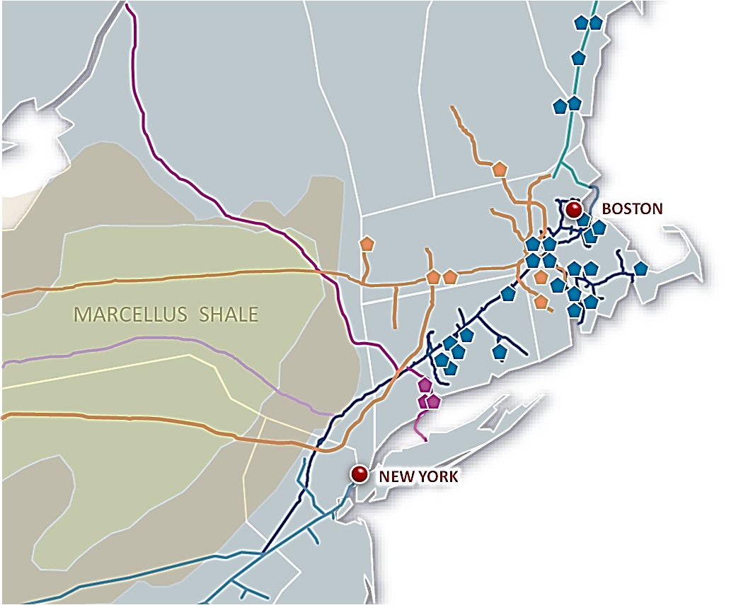
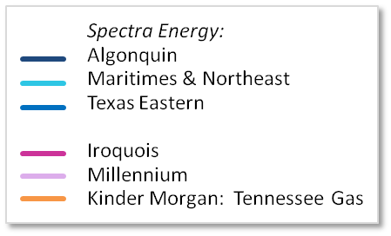
Access Northeast
Opening the Natural Gas
Bottleneck to New England
Announced September 16
NU / Spectra Energy will invest about $3 billion to deliver more than 1 BCF per day to gas-fired power plants and local gas distribution companies
Utilizes existing pipeline rights of way
Expands existing infrastructure
Could serve 60% of New England’s power plants
Target completion 2018-19
Notes:
14
14

Slide 15
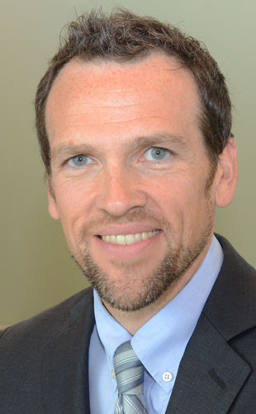

Matt Gibbs
How We Can Help
We can help you manage costs through energy efficiency
Solutions for business customers:
  Small business
  Commercial and municipal
  Industrial
Director, Implementation

Slide 16


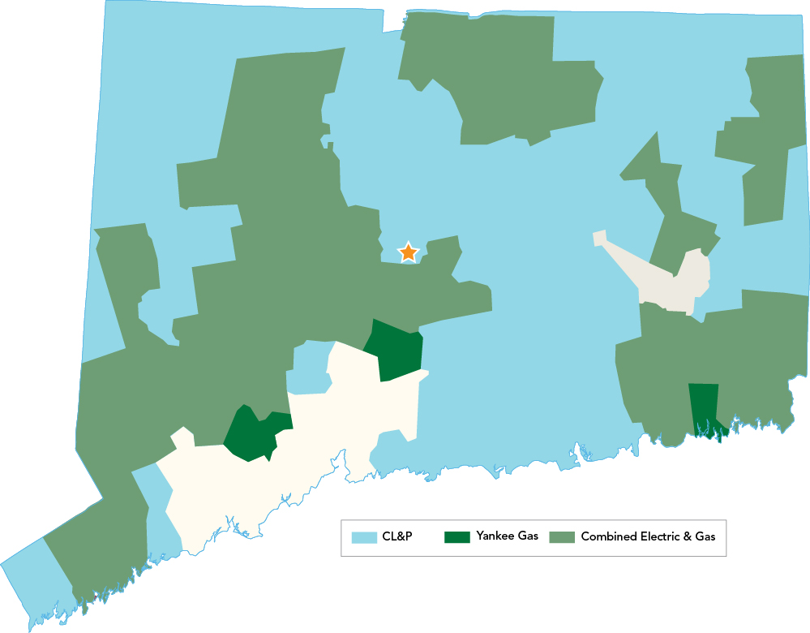
There are many programs available to help you manage costs
How We Can Help
Our energy experts are here to help you cut costs through energy efficiency
  Financial incentives
  Technical assistance
  Financing opportunities for municipal projects
Contact your Account Executive or our Business Center to get started!

Slide 17

Small Business Solutions
How We Can Help
Turnkey
  We provide the energy expertise and the labor so you don’t have to
  Use your own labor or electrical contractor
Lighting and equipment upgrades
  Improve quality and save
Incentives
  Up to 50% of your project

Slide 18

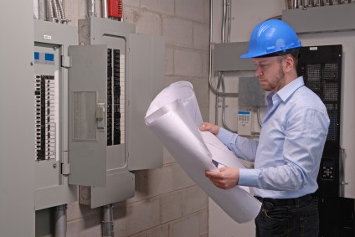
Commercial and Municipal Businesses
How We Can Help
Retro-commissioning
  Ensure your building is performing as intended with retro-commissioning
Incentives
  Help you upgrade to high-efficiency equipment in all aspects of your facility
Rebates
Do more and save more
  Comprehensive projects
New construction opportunities
  Design consultations and incentives for all aspects of you new facility or addition

Slide 19

Industrial Facilities
How We Can Help
Streamline operations through process improvements
Training and educational opportunities to make behavioral and cultural changes
New construction opportunities
  Design consultations and financial incentives for all aspects of your new facility or addition
Incentives for new equipment to expand your business

Slide 20

Prepare now through energy efficiency programs
How We Can Help
We offer energy efficiency solutions to help manage energy costs.
For Business Energy Solutions
Contact your Account Executive
Visit EnergizeCT.com
Call 1-877- WISE USE
Call 888-783-6617, M-F, 8 a.m.-5 p.m., or BusinessContactCenter@nu.com

Slide 21
Questions and Answers
Click on the “Q&A” tool at the bottom of the screen to submit a question
Kevin Charette
Director – Business Center
Northeast Utilities
Matt Gibbs
Director, Implementation
CL&P/Yankee Gas -Connecticut
James Daly
Vice President – Energy Supply
Northeast Utilities

